Slide 1
FADGI's Significant Properties for Digital Video: A Work in Progress
Kate Murray, Library of Congress/FADGI
kmur@loc.gov | @fileformatology
NTTW4 | Budapest, Hungary | December 5, 2019

Slide 2
Project links
Easiest way: http://www.digitizationguidelines.gov/guidelines/sigpropvideo.html
FSPDV Context direct link: http://tiny.cc/8ud9gz
FSPDV Spreadsheet direct link: http://tiny.cc/1vd9gz

Slide 3
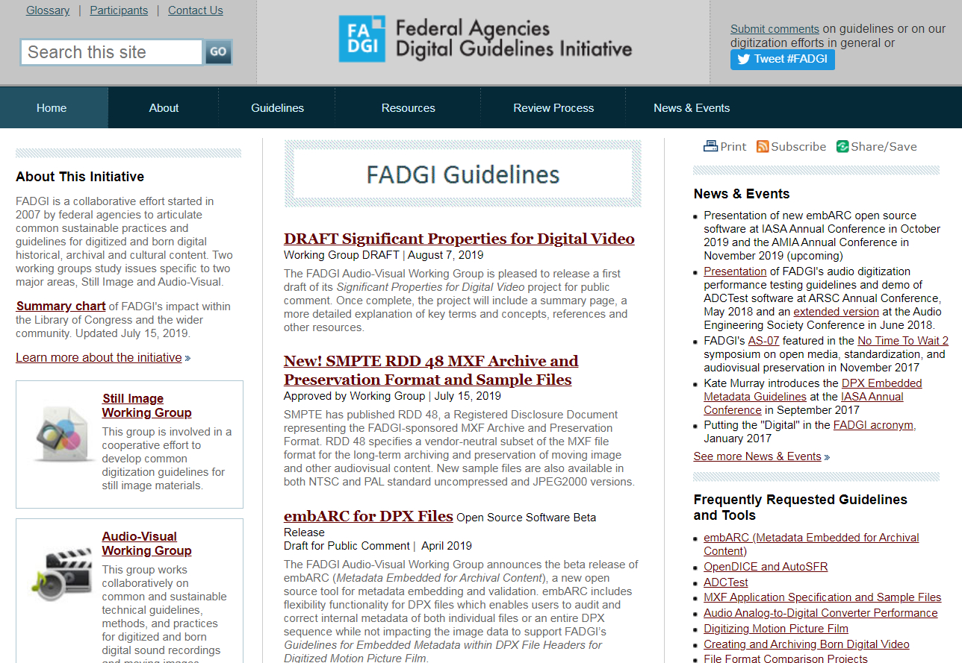
http://www.digitizationguidelines.gov/

Slide 4
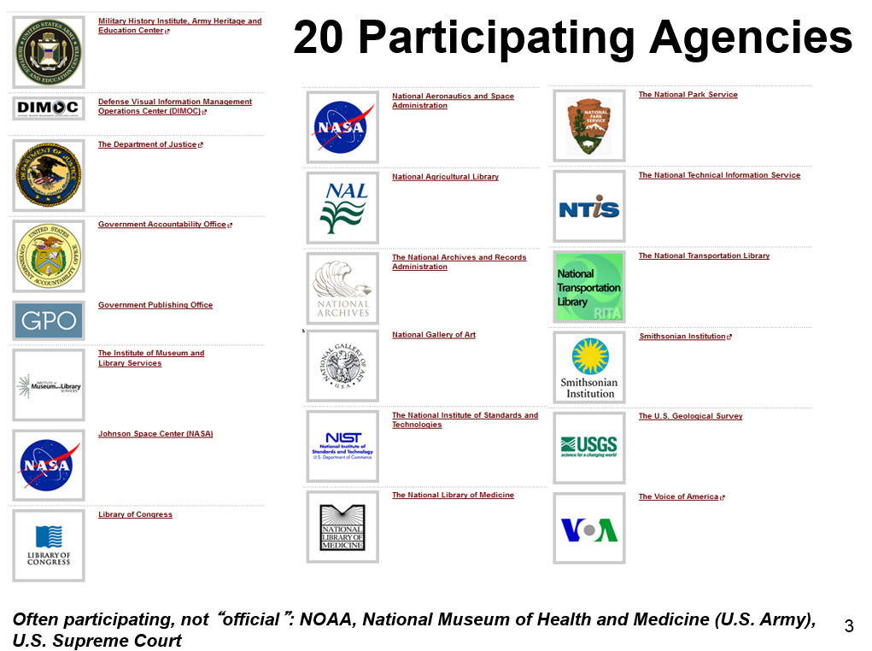

Slide 5
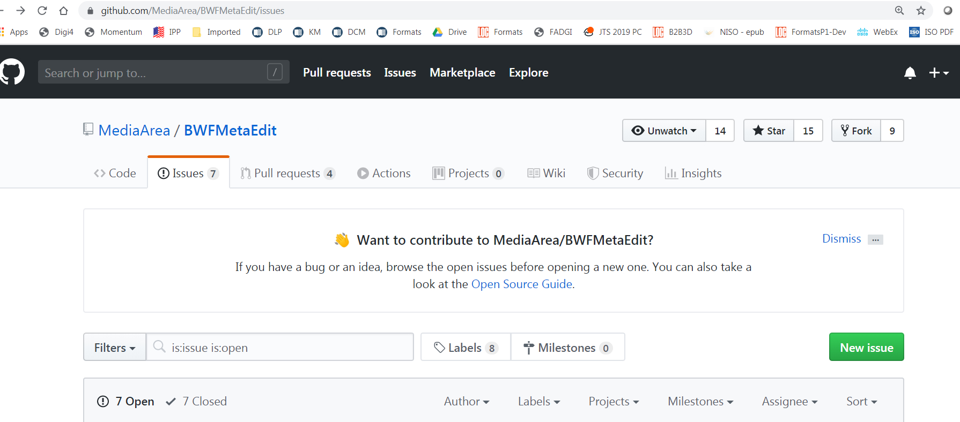
But wait, there’s more!
https://github.com/MediaArea/BWFMetaEdit/issues

Slide 6
Like puffy sleeves, significant properties are back in fashion
Inspired by 2018/2019 “Significant Significant Properties” work:
(Remco van Veenendaal, preservation officer at the National Archives of the Netherlands)
Differs a bit from 2008 JISC report:
Building on previous work

Slide 7
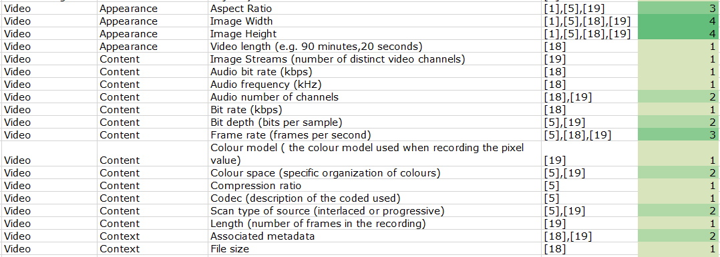
“Significant Significant Properties”
https://openpreservation.org/blog/2018/10/03/initial-list-of-significant-significant-properties-available/

Slide 8
FADGI project scope
What are the significant technical properties in the majority of the digital video we might come across in the GLAM section?
In what ways can those properties be changed?
What is the impact of change on these properties?
(also completely selfish tie-in to FADGI’s 2014 Creating and Archiving Born Digital Video project with high level recommendations: http://www.digitizationguidelines.gov/guidelines/video_bornDigital.html)

Slide 9
FSPDV Data Points
Class of Significant Property (from JISC report)
Property Name
Definition - in depth technical
Definition - summary / lay person
Notes
References for definition
Typical values (not exhaustive list)
*Italics: information we haven’t come across in other SP projects

Slide 10
FSPDV (con’t)
Impact of change on this property
Relevant standards documents
Map to FADGI BDV High Level Recommended Practices
How is this data represented through metadata in commonly used open source tools?
mediainfo
ffprobe
exiftool

Slide 11
What FADGI thinks is, arguably, “significant”
Duration
Number of Moving Image/Video Channels or Tracks
Number of Audio Channels or Audio Tracks
Associated metadata
Display Aspect Ratio (DAR)
Image Size
Audio bit depth
Audio sampling rate
Key - Yellow highlight is not typically found on other projects; Orange highlight is augmented

Slide 12
FADGI properties (con’t)
Video bit depth
Video bit rate
Video bit rate mode (constant/variable)
Frame rate (frames per second)
Color gamut
Color channels
Color model
Color space (specific organization of colours) [ex YUV etc]

Slide 13
FADGI properties (con’t)
Chroma sampling
File format (wrapper/container)
File bitstream encoding
Scan type (interlaced or progressive)
Timecode
File size
Captions/Subtitles
Field order
A few more maybes:
Frame rate mode (constant/variable)
Compression ratio

Slide 14
http://tiny.cc/1vd9gz

Slide 16
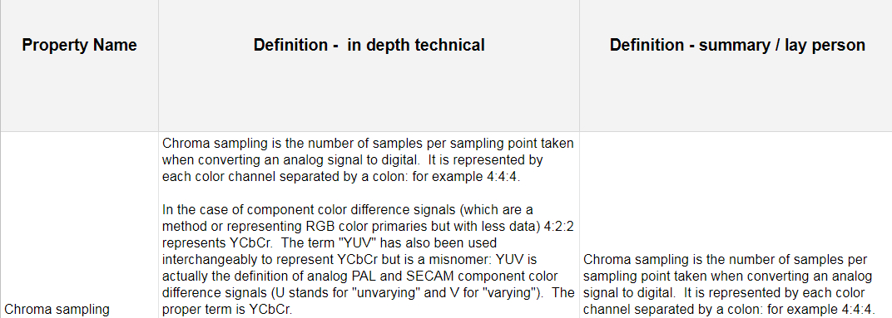
Chroma sampling

Slide 17
Video Tracks or Channels

Slide 18
Sometimes a summary is enough ...
Duration = runtime of the video. Simple, right?

Slide 19
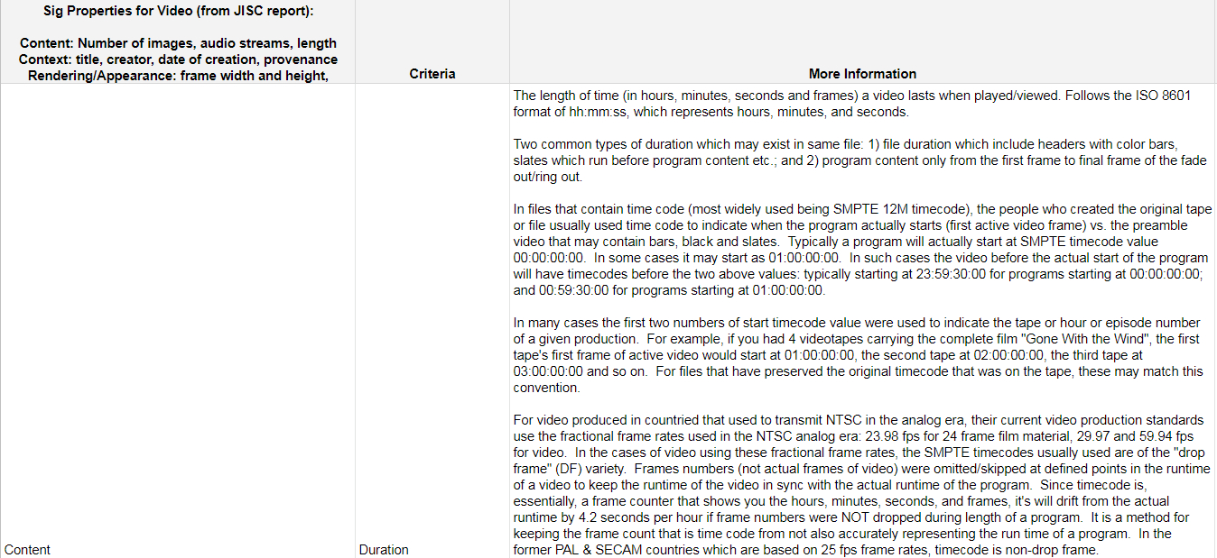
Sometimes engineers are in the room & then this happens ...

Slide 20
We are still very drafty (best intentions and all that...) - lots of “to come”
Once complete, the project will include a summary page (hopefully formatted for printing out on one sheet - like a poster), a more detailed explanation of key terms and concepts, references and other resources.
Comments are ALWAYS welcome!

Slide 21
FADGI Shout Outs to
AJ Lawrence (NMAAHC)
Andy Marchesseault (VOA)
Blake McDowell (NMAAHC)
Charles Hosale (AFC/LC)
Courtney Egan (NARA)
Crystal Sanchez (SI OCIO)
Dan Finn (SAAM)
Hannah Vahle, (NMHM)
Isabel Meyer (SI OCIO)
James Snyder (NAVCC/LC)
Jessie Sims (NARA)
Julia Kim, (AFC/LC)
Kristen Cox (SI OCIO)
Laura Davis (NAVCC/LC)
Lynda Schmitz Fuhrig, (SI Archives)
Pam Commerford (VOA)
Shu-Wen Lin (SAAM)
Steve Berkley (LC AFC)
Taylor McBride (SI OCIO)
Tina Habash (NIH/NLM)

Slide 22
References from this talk
Initial list of Significant Significant Properties available - RvanVeenendaal OPF Blog: https://openpreservation.org/blog/2018/10/03/initial-list-of-significant-significant-properties-available/
The Significant Properties of Moving Images, Mike Coyne and Mike Stapleton, 2008, JISC: https://web.archive.org/web/20091118154024/http://www.jisc.ac.uk/media/documents/programmes/preservation/spmovimages_report.pdf
FADGI Creating and Archiving Born Digital Video, Part III. High Level Recommended Practices: http://www.digitizationguidelines.gov/guidelines/FADGI_BDV_p3_20141202.pdf

Slide 23
Help with IASA TC-07 for Born Digital Video!
Approach: Collaborative transparent authoring
Expectations: Do what you can. Bite of a chunk and write two paragraphs about something you know.
Platform: Open collaborative platforms now being investigated
Aim: firstly, to demystify The Digital Video Trinity – not 1 x format (usually 3 x formats: container, video codec, audio codec)
Contact: Somaya Langley, our fantastic, kind and generous ring-leader - borndigitalvideo@gmail.com; @criticalsenses)
Notes:
born-Digital Video Guidelines (IASA-TC 07)
Approach: Collaborative transparent authoring (the Ashley Blewer & FLOSS Manuals approaches)
Expectations: We're going to do the best we can, with everyone pitching in to write a paragraph or two (or more if you're really committed) about something you each really know about.
Umbrella guidelines: This is likely to be developed as IASA-TC 07 (complimenting IASA-TC 06 for preserving video recordings - focussing on digitised video recordings)
Platform: currently being investigated by Abhi (a lovely Indian sound engineer who we met at the IASA/JTS conference, who is looking into alternatives to Google docs - as people from China want to contribute and Google docs is off the cards). We want the platform to be free for editing, able to be read by anyone while in development, and only to register via email if you want to contribute (and have someone approve the registration through a generic email account).
Scope: The scope/frame of this piece of work is focussed around born-digital file formats and codecs for video
Out of Scope (for now):
Digital Cinema Formats, for where there are settled upon formats/workflows
Digital Video on tape - so we're not duplicating work done elsewhere (e.g. resources on DV on tape could be linked into TC 07 if necessary, such as what Dave's authored) - we don't want to reinvent the wheel (esp. when we're up against limited resources and time.
Interactive video/AV and AR/VR etc - interactive work has really been my passion for 20 years, so it's hard to say this is out of scope. But it must be. That'll be TC 08 or something like that
Aim: firstly, to demystify The Digital Video Trinity – not 1 x format (usually 3 x formats: container, video codec, audio codec)
Principles: Do what you can. Bite of a chunk and write two paragraphs about something you know.
Hands up for contributions already:
Kevin Bradley and Carl Fleishhauer have said they'll write the section on capturing born-digital video for interviews (I think this may be partly drafted already)
A few names from IASA/JTS conference - though not clear what they'll be writing on as it's self nominated
How to get people involved: we're taking the Australian approach of "dob in a mate"
I.e. if you don't want to put your hand up to say you'll write something yourself, then send me details of a friend, family member, colleague etc etc.
Real-world case studies: Peter Bubestinger-Stendl and myself are collecting and documenting case studies/user stories, as a way of being able to illustrate the various issues with born-digital video
Contact: Somaya Langley - as the ring-leader - borndigitalvideo@gmail.com
(or Twitter DM me @criticalsenses - if email is too much of a commitment)
Next steps:
Need to work out what the overall framework is - what should we cover, some top-level headings (input greatly received)
Create document template & draft document structure (in transparent crowdsourced editing environment)
Get NTTW4 peeps to spread this info further in their communities
Ongoing considerations:
Answering high-level questions from the IASA Technical Committee about “what’s different about born-digital video?”
Differences in production workflows, etc.
Open for contributions: we'll make an announcement in mid-late January 2020 about when we're opening up the collaborative editing environment. This gives us time to try find on that will support our needs of multiple authors across multiple countries, including China.

Slide 24
thank you / questions
Kate Murray, Library of Congress/FADGI
kmur@loc.gov | @fileformatology

